Slide 1
Smart Lock Project

Slide 2
5V Stepper Motor
INT 1 = Digital Pin 7
INT 2 = Digital Pin 5
INT 3 = Digital Pin 6
INT 4 = Digital Pin 2
Power = 5V (Arduino Board)

Slide 3
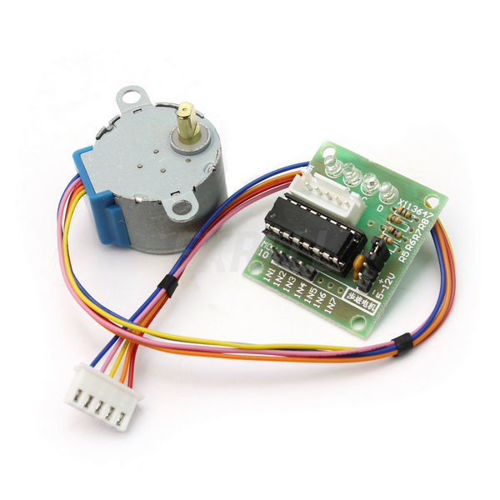
5V Stepper Motor

Slide 4
RFID Scanner
MOSI = Digital Pin 11
MISO = Digital Pin 12
SCK = Digital Pin 13
SDA = Digital Pin 8
RST = Digital Pin 9
Power = 3.5V (Arduino Board)

Slide 5
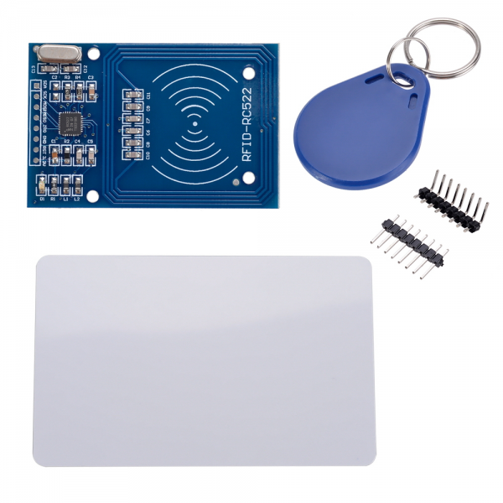

Slide 6
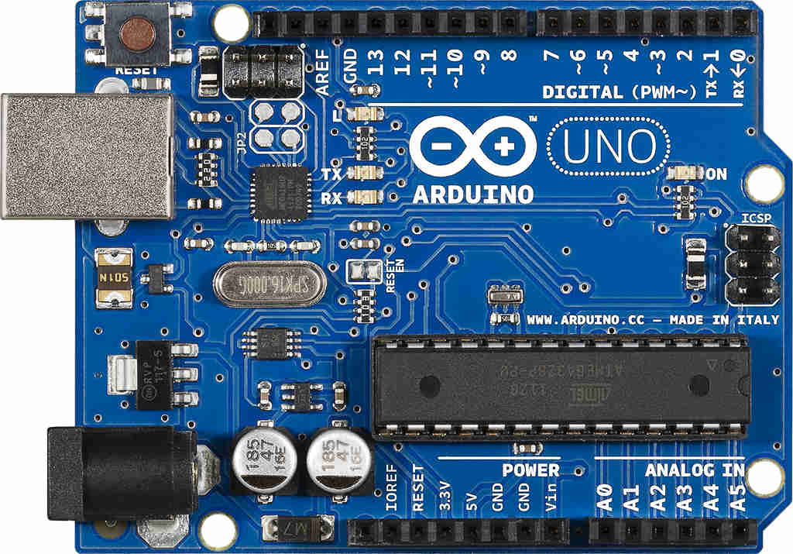
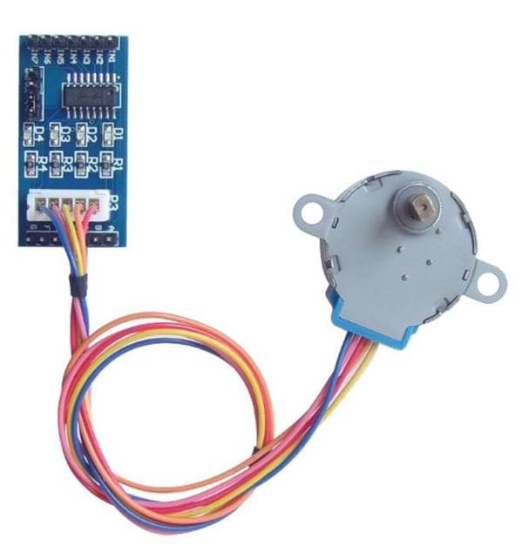

Slide 7
